Slide 1

International Non- Governmental Organisations (INGO)

Slide 2
What is INGO?
In 1910, the Union of International Associations (UIA) were the first to suggest that a "super-national" status be given to international organizations with diplomatic intentions without governmental influence.
After 1929 meetings, UN Charter was finalized, the San Francisco Conference agreed to make provision for both intergovernmental organisations and private organisations to have formal relations with the United Nations Economic and Social Council (ECOSOC).
Article 57 and 71 together formed the concept of INGO, by introducing new terms inter-governmental organisations and non-governmental Organisations, respectively.
The ECOSOC defines an INGO as "any organization which is not established by inter-governmental agreement“, "including organizations which accept members designated by government authorities, provided that such membership does not interfere with the free expression of views of the organizations" .

Slide 3
OPERATIONS AND ACTIVITIES OF INGO
Goals and activities are neither economic nor political in the usual sense. Instead, they are mostly concerned with information, communication, and practical projects to organize global domains or effect global change.
INGOs seek to solve social problems or improve living conditions; others aim to improve technology, advance knowledge, create global standards, protect threatened peoples or species, or induce states, businesses, and individuals to abide by specific norms and principles.
As nonprofit voluntary associations, they rely primarily on donations, member fees, and voluntary labor for their operations. Funding sources include membership dues, the sale of goods and services, private sector for-profit companies, philanthropic foundations, grants from local, state and federal agencies, and private donations. Individual private donors comprise a significant portion of NGO funding.

Slide 4

SOME OF THE LARGEST INGOs:
Amnesty International
‘BETTER TO LIGHT A CANDLE THAN
CURSE THE DARKNESS’
In 1961, British lawyer Peter Benenson was outraged when two Portuguese students were jailed just for raising a toast to freedom. He wrote an article in The Observer newspaper and launched a campaign that provoked an incredible response. Reprinted in newspapers across the world, his call to action sparked the idea that people everywhere can unite in solidarity for justice and freedom. This inspiring moment didn’t just give birth to an extraordinary movement, it was the start of extraordinary social change.
A worldwide campaign movement that seeks to promote all human rights that are established in the Universal Declaration of Human Rights (UDHR) and other international human rights instruments.

Slide 5
Contd..
2.2 million people as members, signatories and supporters spread across 150 countries in the world.
Amnesty has grown from seeking the release of political prisoners to upholding the whole spectrum of human rights. Our work protects and empowers people – from abolishing the death penalty to protecting sexual and reproductive rights, and from combatting discrimination to defending refugees and migrants’ rights.
Therefore, major objectives of organization are: Protection of women, Protection of children, Ending illegal torture and execution, Protection of prisoners of conscience, Protection of refugees Protection and overcoming the phenomenon of human rights violations that are related to his physical and psychological integrity, Abolishing the death penalty, torture and other cruel treatment has held prisoner, Fair and fast trials for political, Prisoners Overcoming the phenomenon of discrimination on any grounds: gender, race, religion, language, political opinion, national or social origin, and others Regulation of the global arms trade.

Slide 6
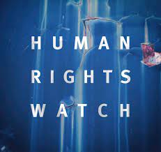
Contd..
2. Human Rights Watch
DEFENDING THE RIGHTS OF PEOPLE
WORLDWIDE
Human Rights Watch was founded in 1978 as “Helsinki Watch,” when we began investigating rights abuses in countries that signed the Helsinki Accords, most notably those behind the Iron Curtain. Since then, our work has expanded to five continents.
Human Rights Watch is an independent, international Organisation that works as part of a vibrant movement to uphold human dignity and advance the cause of human rights for all.
Human Rights Watch is committed to maintaining high standards of accuracy and fairness that includes seeking out multiple perspectives to develop and indepth analytical understanding of events.

Slide 7
Contd…
Main Objectives of Human Rights Watch are as follows:
Investigate: Our researchers work in the field in 100 some countries, uncovering facts that create an undeniable record of human rights abuses.
Expose: We tell the stories of what we found, sharing them with millions of social media and online followers each day. News media often report on our investigations, furthering our reach.
Change: We meet with governments, the United Nations, rebel groups, corporations, and others to see that policy is changed, laws are enforced, and justice is served.

Slide 8

Contd…
3. Greenpeace
Personal responsibility and
nonviolence
In 1971, its founders set sail to an island in the Arctic. Their mission was to stop a nuclear bomb. It was a journey that sparked a movement and made history.
Greenpeace is an independent campaigning organization, which uses non-violent, creative confrontation to expose global environmental problems, and develop solutions for a green and peaceful future to ensure the ability of the earth to nurture life in all its diversity.
They want to—STOP the planet from warming beyond 1.5º to prevent the most catastrophic impacts of the climate breakdown; PROTECT biodiversity in all its forms; SLOW the volume of hyper-consumption and learn to live within our means and PROMOTE renewable energy as a solution that can power the world. Nurture peace, global disarmament and non-violence.

Slide 9
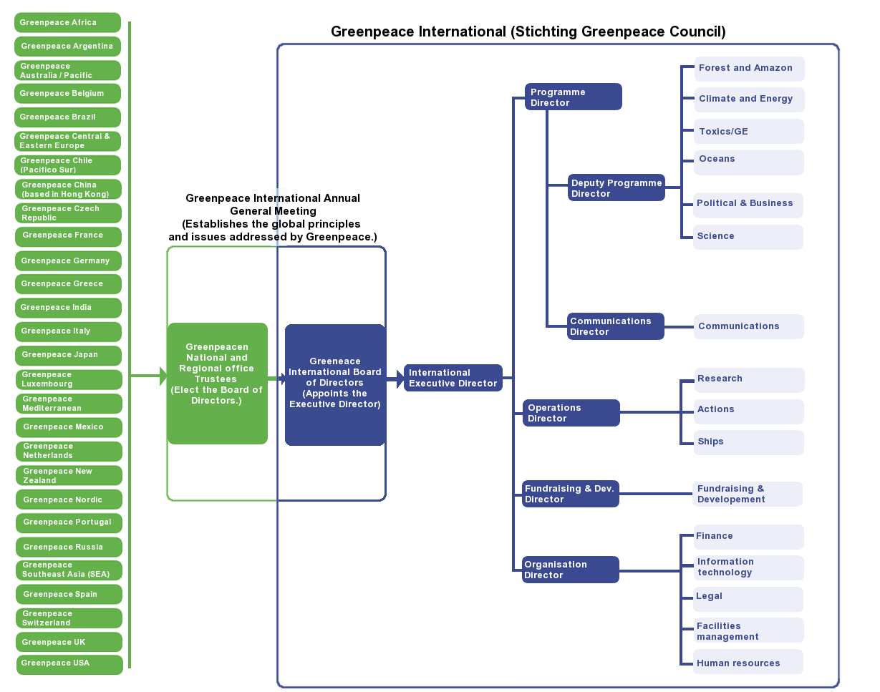
Contd…
The overview of working of
Greenpeace organization

Slide 10
Summary:
The International Telecommunication Union (ITU):originally the International Telegraph Union, ITU was formed at the International Telegraph Convention, held in Paris on 17 May 1865.
The Universal Postal Union (UPU): established by the Treaty of Bern of 1874, is a specialized agency of the United Nations (UN) that coordinates postal policies among member nations.
International Peace Conference originally The Paris Peace Conference: also known as the Versailles Peace Conference, on 18 January 1919 of the victorious Allied Powers following the end of World War I to set the peace terms for the defeated Central Powers.
The International Court of Justice (ICJ): sometimes called the World Court, is the principal judicial organ of the United Nations (UN).
The Permanent Court of Arbitration (PCA): is an intergovernmental Organization located at The Hague in the Netherlands.
The League of Nations: abbreviated as LN or LoN, was an intergovernmental organization founded on 10 January 1920as a result of the Paris Peace Conference that ended the First World War.

Slide 11
Contd…
The United Nations (UN): an intergovernmental Organisation tasked with maintaining international peace and security, developing friendly relations among nations.
The Concert of Europe represented the European balance of power from 1815 to 1848.
The International Labor Organization (ILO) was established as an agency of the League of Nations following World War I.
The International Monetary Fund (IMF), also known as the Fund, is an international Organisation headquartered in Washington, D.C.
The World Bank (WB) also known as the International Bank for Reconstruction and Development (IBRD), is an international financial institution that provides interest-free loans and grants to the governments of poorer countries for the purpose of pursuing capital projects.
The Asian Development Bank (ADB) is a regional development bank established on 19 December 1966, which is headquartered in the Ortigas Center located in the city of Mandaluyong, Metro Manila, Philippines.

Slide 12
Contd…
Amnesty International (commonly known as Amnesty or AI) is an nongovernmental Organization focused on human rights.
Human Rights Watch (HRW) is an international non-governmental Organisation, founded in 1978, headquartered in New York City, that conducts research and advocacy on human rights.
The League Council the main constitutional organs of the League of Nations were the Assembly, the Council, and the Permanent Secretariat.
General Assembly (UNGA or GA) is one of the six principal organs of the United Nations (UN), the only one in which all member nations have equal representation.
Munich Conference: The Conference held in Munich on September 28-29, 1938, during which the leaders of Great Britain, France, and Italy agreed to allow Germany to annex certain areas of Czechoslovakia.
Trusteeship Council is one of the six principal organs of the United Nations, established to help ensure that trust territories were administered in the best interests of their inhabitants and of international peace and security.
International non-governmental Organization (INGO) has the same mission non-governmental Organization (NGO), but it is international in scope and has outposts around the world to deal with specific issues in many countries.

Slide 13
EXERCISE
1. What was the first postal Organization originally called?
(a) International Telegraph (b) International Telecommunication Union
(c) Universal Postal Union (d) International Telecommunication Department
2. In the year 1902, the Convention for the Pacific Settlement of International Disputes
established the ________.
(a) International Court of Justice (b) Permanent Court of Arbitration
(c) International Criminal Court (d) Permanent Court of International Justice
3. Who among the following individuals outlined the idea of the League of nations?
(a) Eleanor Roosevelt (b) Woodrow Wilson
(c) Franklin D Roosevelt (d) Theodore Roosevelt
4. The 1938 Munich Conference agreed to the dismantling of ________.
(a)Yugoslavia (b) Czechoslovakia
(c) Austria (d) Poland

Slide 14
5. Who coined the name United Nations?
(a) Eleanor Roosevelt (b) Woodrow Wilson
(c) Franklin D Roosevelt (d) Theodore Roosevelt
6. Veto powers in the United Nations were given to which of the following five counties
(a) China, Britain, France, USA, Japan (b) China, France, Great Britain, USA, Russia
(c) China, France, Britain, USA, Germany (d) China, France, Great Britain, USA, Soviet Union
7. Match the Following:
1. General Assembly a) Decolonization Process
2. Economic and Social Council b) The Main Deliberative organ of the United Nations
3. International Criminal Court c) China, France, Great Britain, USA, Soviet Union
4. The Security Council d) UNESCO
1) b a d c 2) b d a c
3) c b a d 4) a d b c

Slide 15
8. Match the following:
1. Kurt Waldheim a) Portugal
2. Kofi-Annan b) Republic of Korea
3. Boutros Boutros-Ghali c) Myanmar
4. Antonio Guteres d) Norway
1) a d b c 2) b d a c
3) c b a d 4) a d b c
9. Name two International Non-Governmental Organisations that work for the protection and promotion of human rights
(a) Human Rights Watch (b) Amnesty International
(c) The World Bank (d) Asian Development Bank

